Slide 1

Lecture 8
Getting Funding or Financing
Charlotte Adjanor-Doku, PhD
Department of Human Resource & Organisational Development
KNUST School of Business
cadjanor-doku@knust.edu.gh

Slide 2
Chapter Objectives 1 of 2
Describe the importance of financing for entrepreneurial success.
Explain why most entrepreneurial ventures need to raise money during their early life.
Identify and describe the three sources of personal financing available to entrepreneurs.
Identify and explain the three steps involved in properly preparing to raise debt or equity financing.
Explain the three most important sources of equity funding that are available to the entrepreneurial firm.

Slide 3
Chapter Objectives 2 of 2
Describe common sources of debt financing entrepreneurial firms use.
Describe several creative sources of financing entrepreneurial firms may choose to use.

Slide 4
The Importance of Getting Financing or Funding
The Nature of the Funding and Financing Process
Few people deal with the process of raising investment capital until they need to raise capital for their own firm.
As a result, many entrepreneurs go about the task of raising capital haphazardly because they lack experience in this area.
Why Most New Ventures Need Funding
There are three reasons most new ventures need to raise money during their early life.
The three reasons are shown on the following slide.

Slide 5
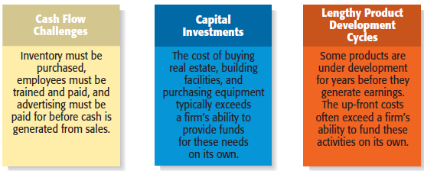
Why Most New Ventures Need Financing or Funding

Slide 6
Alternatives for Raising Money for a New Venture
Personal Funds
Equity Capital
Debt Financing
Creative Sources

Slide 7
Sources of Personal Financing 1 of 2
Personal Funds
The vast majority of founders contribute personal funds, along with sweat equity, to their ventures.
Sweat equity represents the value of the time and effort that a founder puts into a new venture.
Friends and Family
Friends and family are the second source of funds for many new ventures.

Slide 8
Sources of Personal Financing 2 of 2
Bootstrapping
A third source of seed money for a new venture is referred to as bootstrapping.
Bootstrapping is finding ways to avoid the need for external financing or funding through creativity, ingenuity, thriftiness, cost cutting, or any means necessary.
Many entrepreneurs bootstrap out of necessity.

Slide 9
Examples of Bootstrapping Methods
Buy used instead of
new equipment.
Coordinate purchases
with other businesses.
Lease equipment
instead of buying.
Obtain payments in
advance from
customers.
Minimize personal
expenses.
Avoid unnecessary
expenses.
Buy items cheaply but
prudently via options
such as eBay.
Share office space or
employees with other
businesses.
Hire interns.

Slide 10
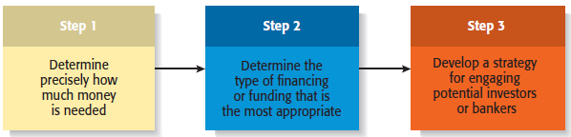
Preparing to Raise Debt or Equity Financing 1 of 3

Slide 11
Preparing to Raise Debt or Equity Financing 2 of 3
Two Most Common Alternatives
Equity Funding
Debt Financing
Means exchanging partial ownership in a firm, usually in the form of stock, for funding.
Is getting a loan.

Slide 12
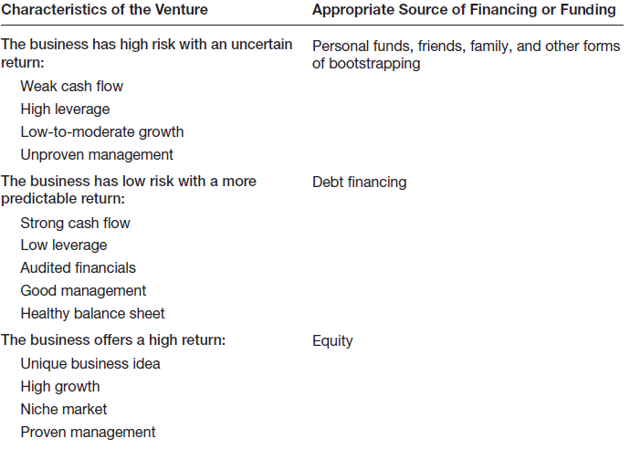
Preparing to Raise Debt or Equity Financing 3 of 3
Matching a New Venture’s Characteristics with the Appropriate Form of Financing or Funding

Slide 13
Preparing an Elevator Speech 1 of 2
Purpose
An elevator speech is a brief,
carefully constructed statement
that outlines the merits of a
business opportunity.
There are many occasions when a
carefully constructed elevator
speech might come in handy.
Most elevator speeches are
around 60 seconds long.
Elevator Speech

Slide 14
Preparing an Elevator Speech 2 of 2
Step 1
Describe the opportunity or problem that needs to be solved.
20 seconds
Describe how your product meets the opportunity or solves the problem.
20 seconds
Step 2
Step 3
Describe your qualifications.
10 seconds
Describe your market.
Step 4
10 seconds
Total
60 seconds

Slide 15
Sources of Equity Funding
Venture Capital
Business Angels
Initial Public Offerings

Slide 16
Business Angels 1 of 2
Business Angels
Are individuals who invest their personal capital directly in start-ups.
The prototypical business angel is about 50 years old, has high income and wealth, is well educated, has succeeded as an entrepreneur, and is interested in the start-up process.
The number of angel investors in the U.S. has increased dramatically over the past decade.

Slide 17
Business Angels 2 of 2
Business Angels (continued)
Business angels are valuable because of their willingness to make relatively small investments.
These investors generally invest between $10,000 and $500,000 in a single company.
Are looking for companies that have the potential to grow between 30% to 40% per year.
Business angels are difficult to find.

Slide 18
Venture Capital 1 of 3
Venture Capital
Is money that is invested by venture capital firms in start-ups and small businesses with exceptional growth potential.
There are about 875 venture capital firms in the U.S.
Venture capital firms are limited partnerships of money managers who raise money in “funds” to invest in start-ups and growing firms.
The funds, or pool of money, are raised from wealthy individuals, pension plans, university endowments, foreign investors, and similar sources.
The investors who invest in venture capital funds are called limited partners. The venture capitalists are called general partners.

Slide 19
Venture Capital 2 of 3
Venture Capital (continued)
Venture capital firms fund very few entrepreneurial firms in comparison to business angels.
Many entrepreneurs get discouraged when they are repeatedly rejected for venture capital funding, even though they may have an excellent business plan.
Venture capitalists are looking for the “home run” and so reject the majority of the proposals they consider.
A distinct difference between angel investors and venture capital firms is that angels tend to invest earlier in the life of a company, whereas venture capitalists come in later.

Slide 20
Venture Capital 3 of 3
Venture Capital (continued)
An important part of obtaining venture capital funding is going through the due diligence process.
Venture capitalists invest money in start-ups in “stages,” meaning that not all the money that is invested is disbursed at the same time.
Some venture capitalists also specialize in certain “stages” of funding.

Slide 21
Initial Public Offering 1 of 3
Initial Public Offering
An initial public offering (IPO) is a company’s first sale of stock to the public. When a company goes public, its stock is traded on one of the major stock exchanges.
Most entrepreneurial firms that go public trade on the NASDAQ, which is weighted heavily toward technology, biotech, and small-company stocks.
An IPO is an important milestone for a firm. Typically, a firm is not able to go public until it has demonstrated that it is viable and has a bright future.

Slide 22
Initial Public Offering 2 of 3
Reasons that Motivate Firms to Go Public
Reason 1
Reason 2
Is a way to raise equity capital to fund current and future operations.
Raises a firm’s public profile, making it easier to attract high-quality customers and business partners.

Slide 23
Initial Public Offering 3 of 3
Reasons that Motivate Firms to Go Public
Reason 3
Reason 4
Is a liquidity event that provides a means for a company’s investors to recoup their investments.
Creates a form of currency that can be used to grow the company via acquisitions.

Slide 24
Sources of Debt Financing
Commercial Banks
SBA Guaranteed Loans

Slide 25
Commercial Banks
Banks
Historically, commercial banks have not been viewed as a practical source of financing for start-up firms.
This sentiment is not a knock against banks; it is just that banks are risk averse, and financing start-ups is a risky business.
Banks are interested in firms that have a strong cash flow, low leverage, audited financials, good management, and a healthy balance sheet.

Slide 26
Other Sources of Debt Financing 1 of 2
Vendor Credit
Also known as trade credit, is when a vendor extends credit to a business in order to allow the business to buy its products and/or services up front but defer payment until later.
Factoring
Is a financial transaction whereby a business sells its accounts receivable to a third party, called a factor, at a discount in exchange for cash.

Slide 27
Other Sources of Debt Financing 2 of 2
Merchant Cash Advance
Type of loan in which the lender provides a business a lump sum of money in exchange for a share of future sales that covers the payment plus fees.
These types of loan are arranged by online firms at an escalated interest rate.
Peer-to-Peer Lending
Is a financial transaction that occurs directly between individuals or peers.
The loans are facilitated by online firms such as Funding Circle, Lending Club, and Dealstruck.

Slide 28
Creative Sources of Financing or Funding
Crowdfunding
Leasing
Strategic Partners
Other Grant Programs

Slide 29
Crowdfunding 1 of 2
Crowdfunding
Crowdfunding is the practice of funding a project or new venture by raising monetary contributions from a large number of people (the “crowd”) typically via the Internet.
Two Types of Crowdfunding Programs
Rewards-based crowdfunding allows entrepreneurs to raise money in exchange for some type of amenity or reward.
The most popular rewards-based crowdfunding sites are Kickstarter, Indiegogo, and RocketHub.

Slide 30
Crowdfunding 2 of 2
Two Types of Crowdfunding Programs (continued)
Equity-based crowdfunding helps businesses raise money by tapping individuals who provide funding in exchange for equity in the business.
The catalyst for the advent of equity-based crowdfunding was the JOBS Act, which was passed in April 2012.
It appears that equity-based crowdfunding will be confined to entrepreneurs raising money from accredited investors.
Equity-based crowdfunding sites include FundersClub, Crowdfunder.com, and Circle Up.

Slide 31
Leasing 1 of 2
Leasing
A lease is a written agreement in which the owner of a piece of property allows an individual or business to use the property for a specified period of time in exchange for payments.
The major advantage of leasing is that it enables a company to acquire the use of assets with very little or no down payment.

Slide 32
Leasing 2 of 2
Leasing (continued)
Most leases involve a modest down payment and monthly payments during the duration of the lease.
At the end of an equipment lease, the new venture typically has the option to stop using the equipment, purchase it for fair market value, or renew the lease.
Leasing is almost always more expensive than paying cash for an item, so most entrepreneurs think of leasing as an alternative to equity or debt financing.

Slide 33
Strategic Partners 1 of 2
Strategic Partners
Strategic partners are another source of capital for new ventures.
Many partnerships are formed to share the costs of product or service development, to gain access to particular resources, or to facilitate speed to market.
Older established firms benefit by partnering with young entrepreneurial firms by gaining access to their creative ideas and entrepreneurial spirit.

Slide 34
Strategic Partners 2 of 2
Biotech firms often partner
with large drug companies
to conduct clinical trials and
bring new products to
market.
The biotech firms benefit by
obtaining funding from their
partners, and the partners
benefit by having additional
products to sell.

Slide 35

ANY QUESTION?

Slide 36
THANK YOU

